Slide 1


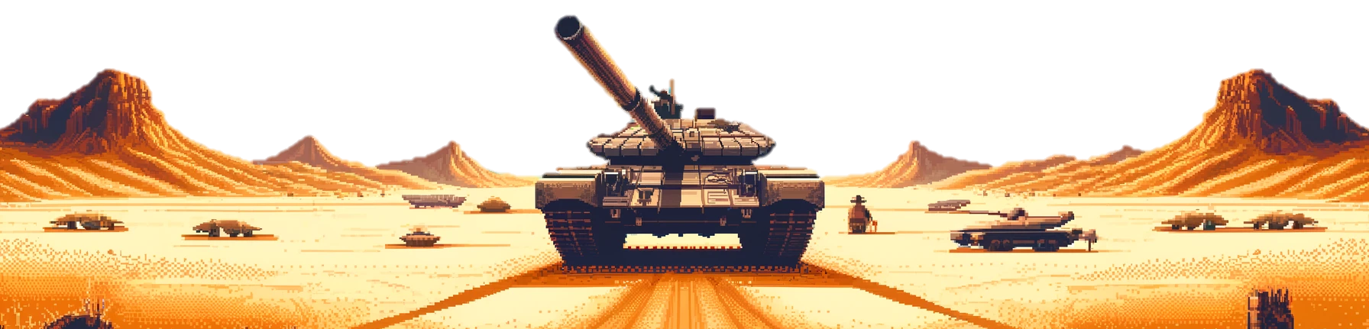
Scrummy
Tankers
Scrummy
Tankers

Slide 2

Team Roles
Team Roles
Carson Mead (Team Lead)
Jonathan Perkins (Security)
Jon Oliva
Jordan Schnell
Bhayva Sharma

Slide 3
Project
Project
A recreation of the Atari classic, Combat
Two tanks compete against each other
Navigating walls, shooting each other
Programmed in Python
Used PyGame / PyTMX imports

Slide 4
Scope
Scope
Atari Combat replica with the following features:
One level of gameplay
Start, game over, and instruction screens
Two tanks controlled via keyboard controls
Tanks limited by wall boundaries
Tanks can shoot each other to earn points

Slide 5
Outcome
Outcome
Working deliverable of scope requirements
Experience with PyGame development
Increased GitHub skills
Project initialization
Markdown documents
Remote / local repository integration

Slide 6
Demo Time…
Demo Time…

